Slide 1

Macroeconomics
Sixth Canadian Edition
Chapter 9
A Two-Period Model: The Consumption–Savings Decision and Credit Markets
Copyright © 2021 Pearson Canada Inc.
Notes:
If this PowerPoint presentation contains mathematical equations, you may need to check that your computer has the following installed:
1) MathType Plugin
2) Math Player (free versions available)
3) NVDA Reader (free versions available)

Slide 2
Chapter 9 Topics
Consumer’s consumption/savings decision – responses of consumer to changes in income and interest rates.
Government budget deficits and the Ricardian Equivalence Theorem.

Slide 3

Budget Constraints (1 of 2)
The consumer’s current-period budget constraint:

Slide 4

Budget Constraints (2 of 2)
The consumer’s future-period budget constraint:

Slide 5

Simplify
Solve the future-period budget constraint for s:

Slide 6

Next,
Substitute in the current-period budget constraint obtaining lifetime budget constraint:

Slide 7

Consumer’s Lifetime Budget Constraint
Substitute in the current-period budget constraint obtaining lifetime budget constraint:

Slide 8

Consumer’s Lifetime Wealth

Slide 9

Simplified Lifetime Budget Constraint

Slide 10

Simplified Lifetime Budget Constraint: Slope-Intercept

Slide 11
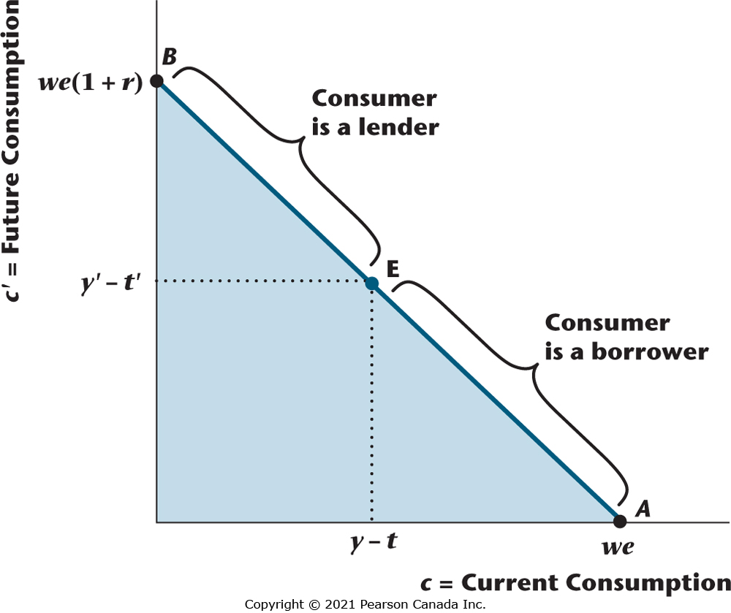
Figure 9.1 Consumer’s Lifetime Budget Constraint
The lifetime budget constraint defines the quantities of current and future consumption the consumer can acquire, given current and future income and taxes, through borrowing and lending on the credit market. To the northwest of the endowment point E, the consumer is a lender with positive savings; to the southeast of E, he or she is a borrower with negative savings.

Slide 12
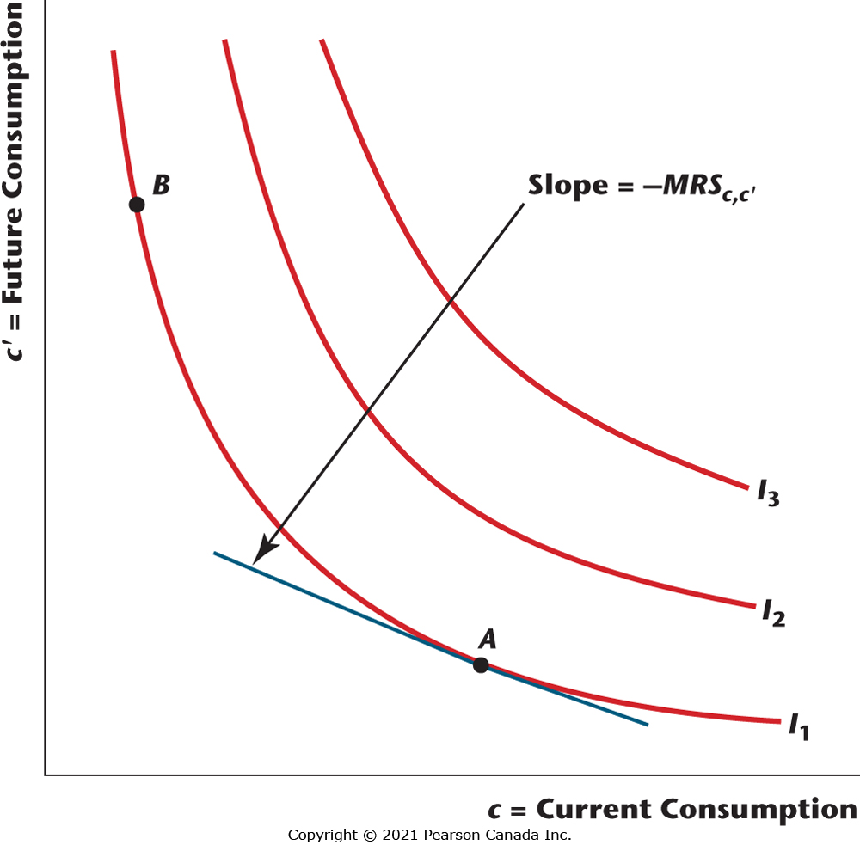
Figure 9.2 A Consumer’s Indifference Curves
The figure shows the indifference map of a consumer. Indifference curves are convex and downward-sloping. Minus the slope of an indifference curve is the marginal rate of substitution of current consumption for future consumption.

Slide 13

Optimization
Marginal condition that holds when the consumer is optimizing:

Slide 14
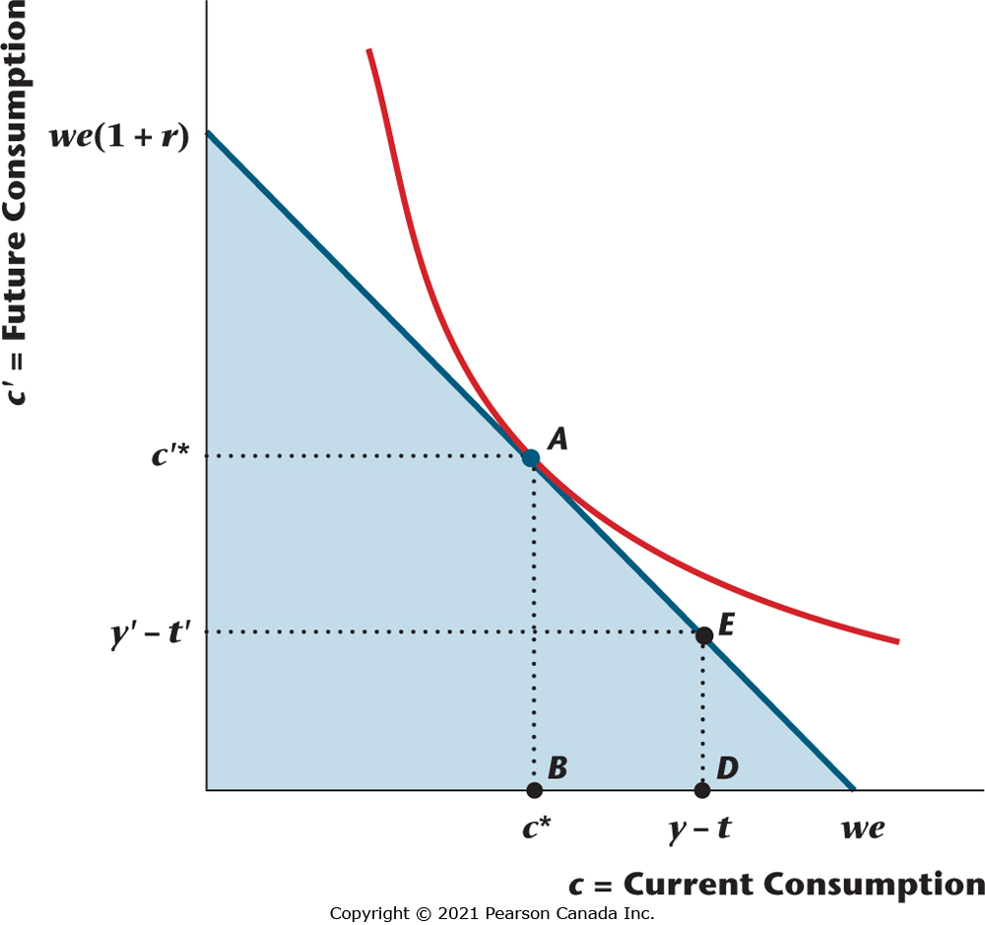
Figure 9.3 A Consumer Who is a Lender
The optimal consumption bundle for the consumer is at point A, where the marginal rate of substitution (minus the slope of an indifference curve) is equal to 1 + r (minus the slope of the lifetime budget constraint). The consumer is a lender, as the consumption bundle chosen implies positive savings, with E being the endowment point.

Slide 15
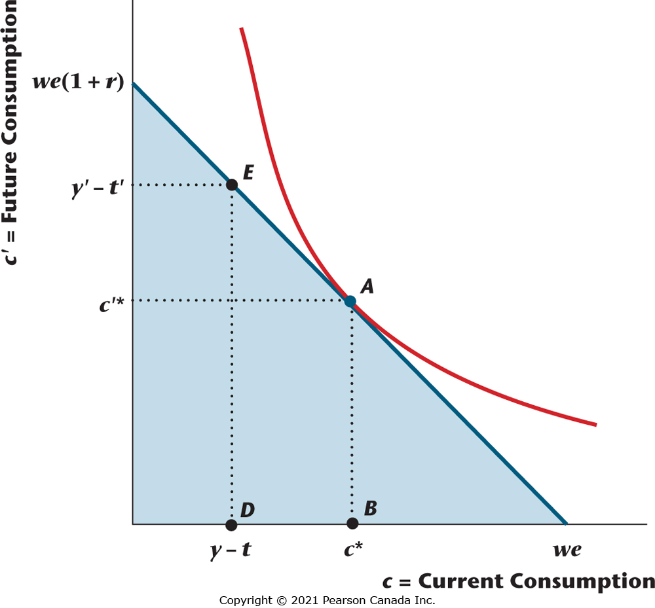
Figure 9.4 A Consumer Who is a Borrower
The optimal consumption bundle is at point A. Since current consumption exceeds current disposable income, saving is negative, and so the consumer is a borrower.

Slide 16
An Increase in Current Income for the Consumer
Current and future consumption increase.
Saving increases.
The consumer acts to smooth consumption over time.

Slide 17
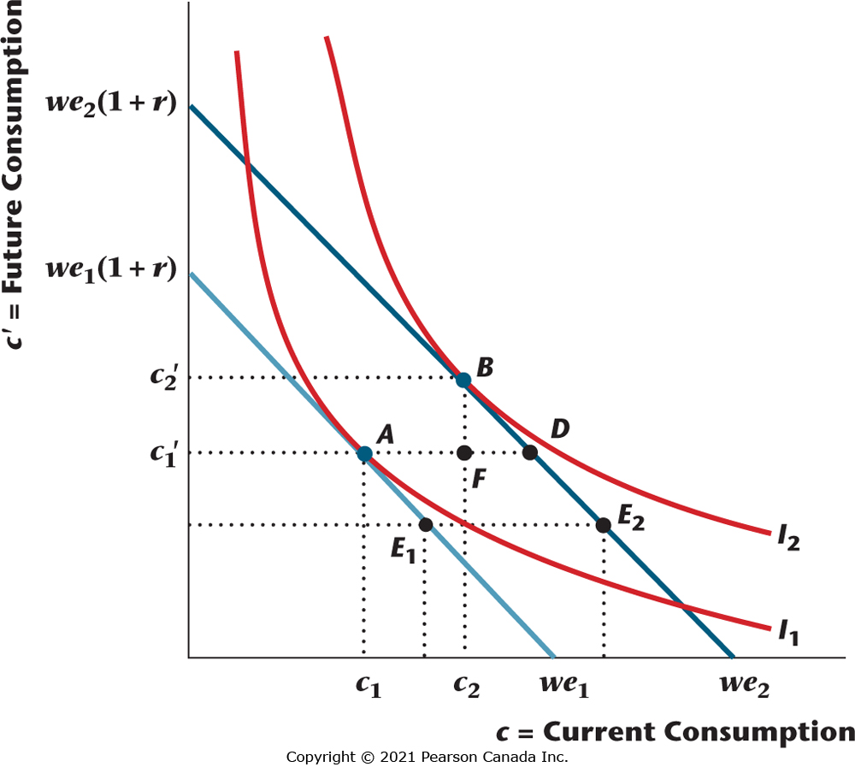
Figure 9.5 The Effects of an Increase in Current Income for a Lender
When current income increases, lifetime wealth increases from we₁ to we₂. The lifetime budget constraint shifts out, and the slope of the constraint remains unchanged, since the real interest rate does not change. Initially, the consumer chooses A, and he or she chooses B after current income increases. Current and future consumption both increase (both goods are normal), and current consumption increases by less than the increase in current income.

Slide 18
Observed Consumption-Smoothing Behaviour
Aggregate consumption of non-durables and services is smooth relative to aggregate income, but the consumption of durables is more volatile than income.
This is because durables consumption is economically more like investment than consumption.

Slide 19
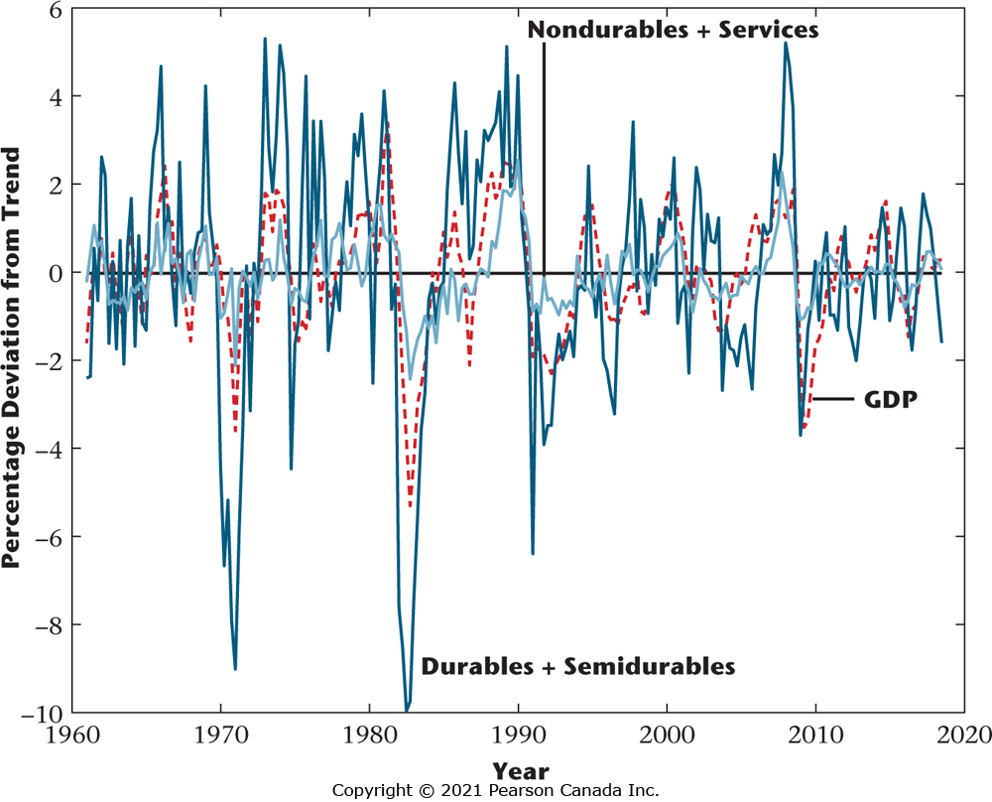
Figure 9.6 Percentage Deviations from Trend in GDP and Consumption 1961–2018.
Consumption of durables and semi-durables is much more variable than GDP, which is much more variable than consumption of nondurables and services. The consumption-smoothing behaviour of consumers is clearly reflected in the behaviour of nondurables and services.

Slide 20
An Increase in Future Income for the Consumer
Aggregate consumption of non-durables and services is smooth relative to aggregate income, but the consumption of durables is more volatile than income.
This is because durables consumption is economically more like investment than consumption.

Slide 21
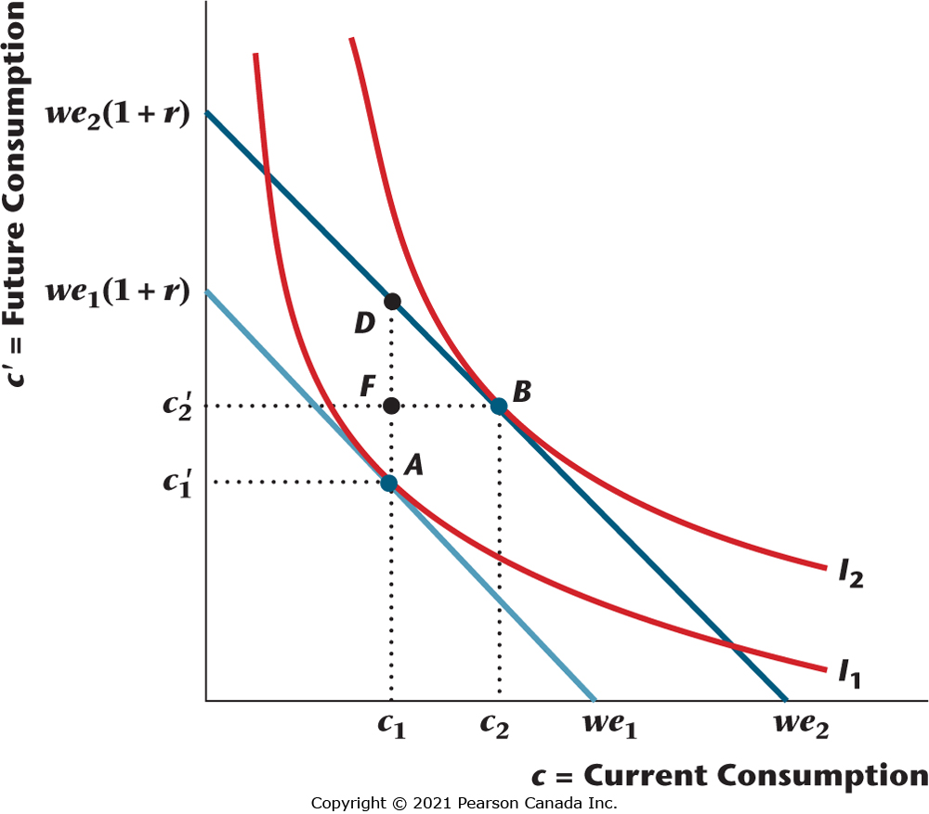
Figure 9.7 An Increase in Future Income
An increase in future income increases lifetime wealth from we₁ to we₂, shifting the lifetime budget constraint up and leaving its slope unchanged. The consumer initially chooses point A, and he or she chooses B after the budget constraint shifts. Future consumption increases by less than the increase in future income, saving decreases, and current consumption increases.

Slide 22
Temporary and Permanent Increases in Income
As a permanent increase in income will have a larger effect on lifetime wealth than a temporary increase, there will be a larger effect on current consumption.
A consumer will tend to save most of a purely temporary income increase.

Slide 23
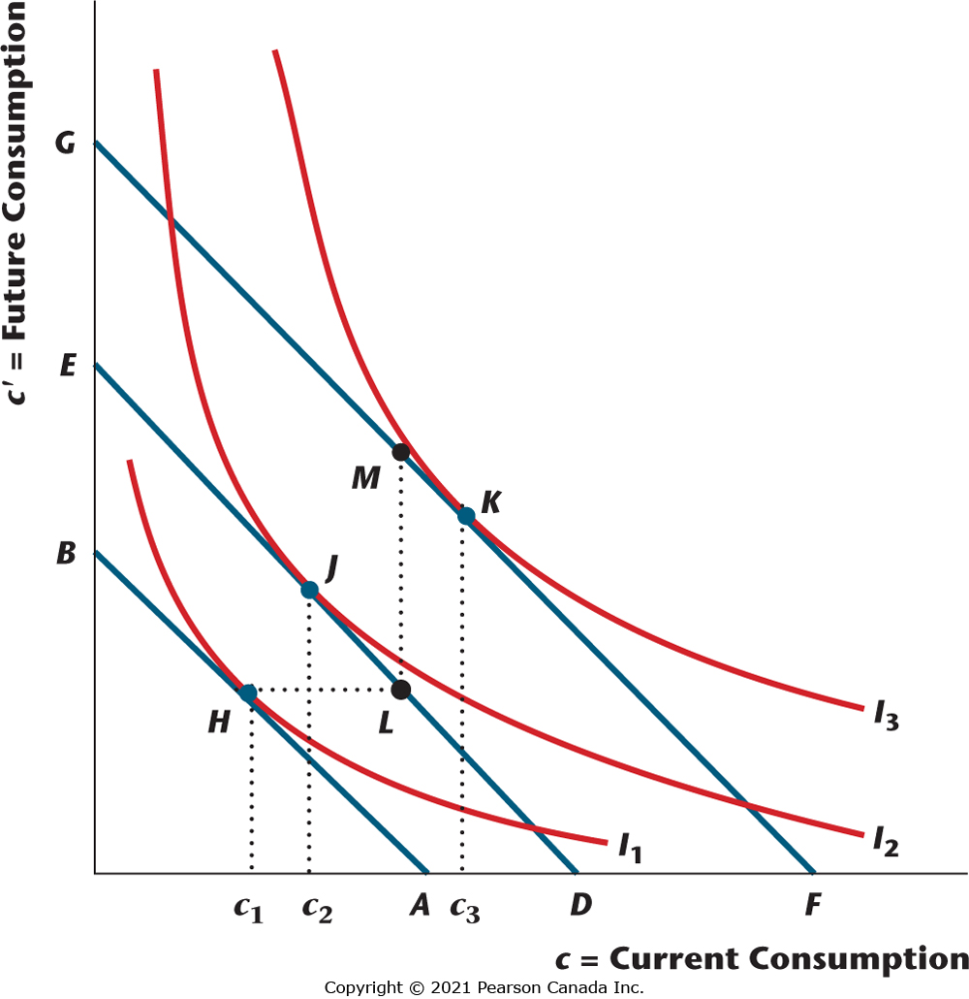
Figure 9.8 Temporary vs. Permanent Increases in Income
A temporary increase in income is an increase in current income, with the budget constraint shifting from AB to DE, and the optimal consumption bundle changing from H to J. When there is a permanent increase in income, current and future income both increase, and the budget constraint shifts from AB to FG, with the optimal consumption bundle changing from H to K.

Slide 24
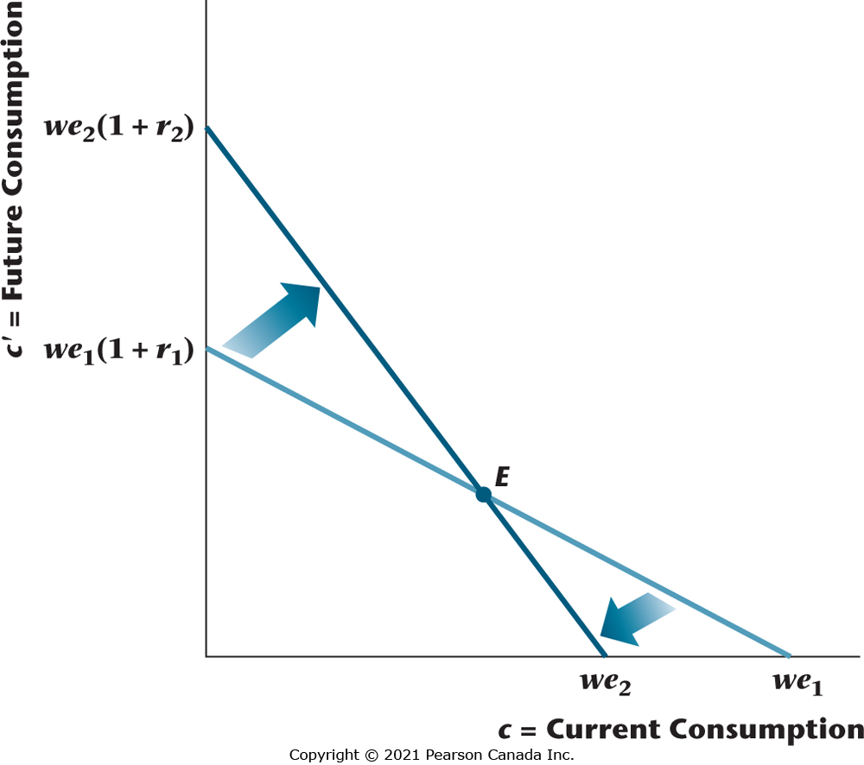
Figure 9.11 An Increase in the Real Interest Rate
An increase in the real interest rate causes the lifetime budget constraint of the consumer to become steeper and to pivot around the endowment point E.

Slide 25
An Increase in the Market Real Interest Rate
An increase in the market real interest rate decreases the relative price of future consumption goods in terms of current consumption goods – this has income and substitution effects for the consumer.

Slide 26
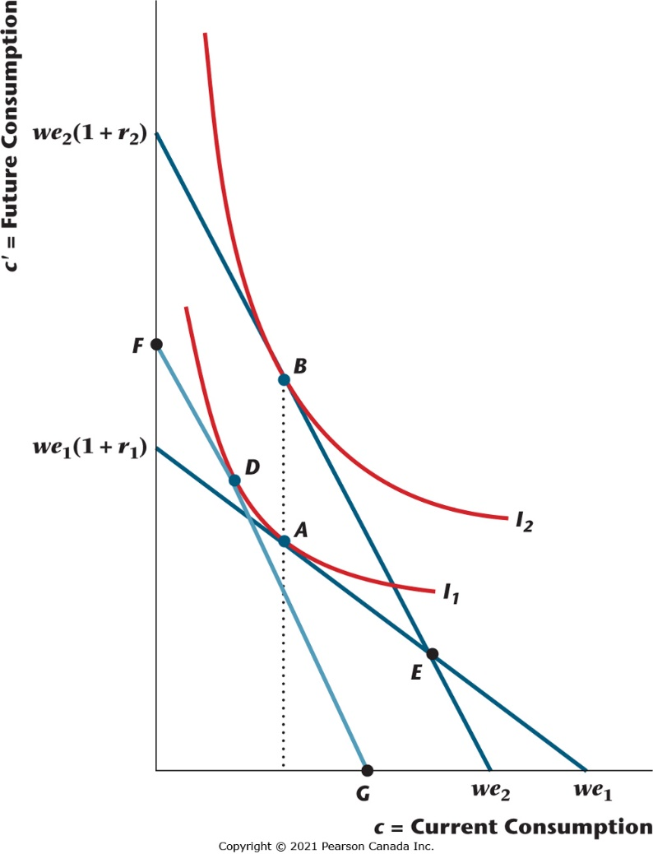
Figure 9.12 An Increase in the Real Interest Rate for a Lender
When the real interest rate increases for a lender, the substitution effect is the movement from A to D, and the income effect is the movement from D to B. Current consumption and saving may rise or fall, while future consumption increases.

Slide 27
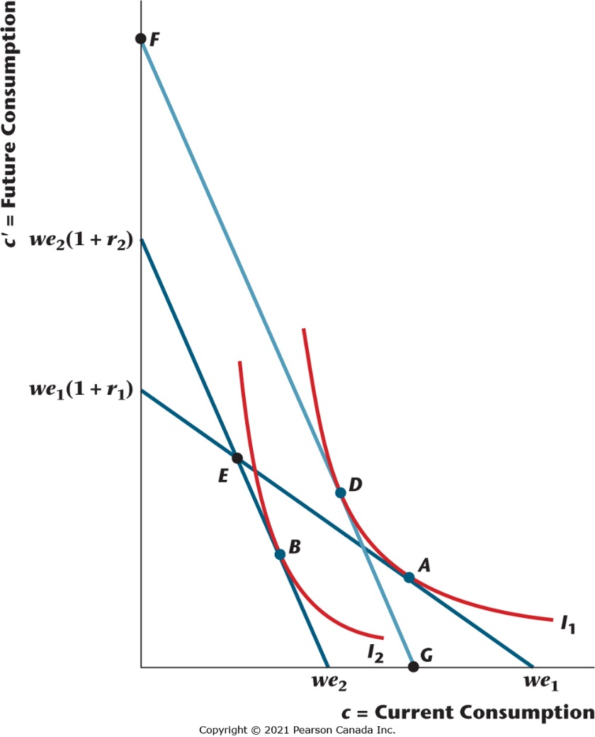
Figure 9.13 An Increase in the Real Interest Rate for a Borrower
When the real interest rate increases for a borrower, the substitution effect is the movement from A to D, and the income effect is the movement from D to B. Current consumption decreases, saving increases, and future consumption may rise or fall.

Slide 28
Effects of an Increase in the Real Interest Rate for a Lender
Table 9.2 Effects of an Increase in the Real Interest Rate for a Lender
Current consumption | ?
Future consumption | Increases
Current savings | ?

Slide 29
Effects of an Increase in the Real Interest Rate for a Borrower
Table 9.3 Effects of an Increase in the Real Interest Rate for a Borrower
Current consumption | Decreases
Future consumption | ?
Current savings | Increases

Slide 30


Perfect Complements Example (1 of 3)
With perfect complements, the ratio of future consumption to current consumption is constant.
The consumer’s budget constraint must hold.

Slide 31


Perfect Complements Example (2 of 3)
With perfect complements we can solve explicitly for current and future consumption:

Slide 32
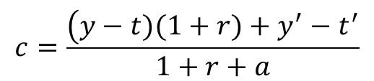
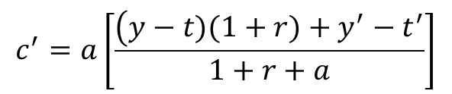
Perfect Complements Example (3 of 3)
Substituting for lifetime wealth gives:

Slide 33
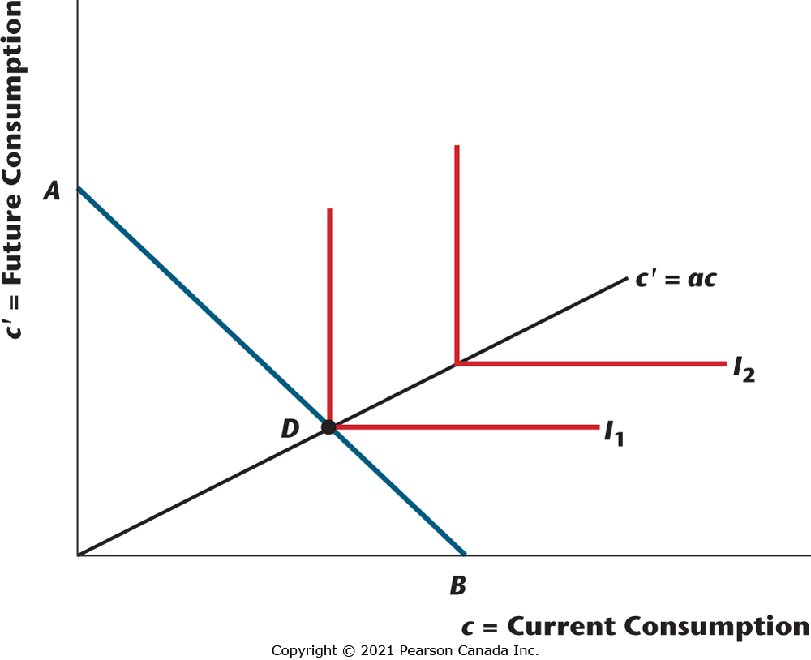
Figure 9.14 Example with Perfect Complements Preferences
The consumer desires current and future consumption in fixed proportions, with c’ = ac. With indifference curves representing perfect complementarity between current and future consumption, the optimal consumption bundle is at point D on the lifetime budget constraint AB.

Slide 34

Government Budget Constraints (1 of 3)
The government’s current-period budget constraint:

Slide 35

Government Budget Constraints (2 of 3)
The government’s future-period budget constraint:

Slide 36
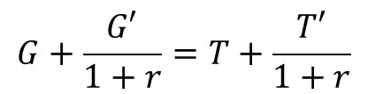
Government Budget Constraints (3 of 3)
The government’s present-value budget constraint:

Slide 37

Credit Market Equilibrium Condition
Total private savings is equal to the quantity of government bonds issued in the current period.

Slide 38

Income-Expenditure Identity
Credit market equilibrium implies that the income-expenditure identity holds.

Slide 39
Ricardian Equivalence (1 of 3)
The Ricardian Equivalence Theorem is illustrated algebraically, numerically, and in two graphs.

Slide 40
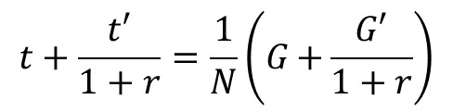
Ricardian Equivalence (2 of 3)
Key equation: The consumer’s lifetime tax burden is equal to the consumer’s share of the present value of government spending – the timing of taxation does not matter for the consumer.

Slide 41
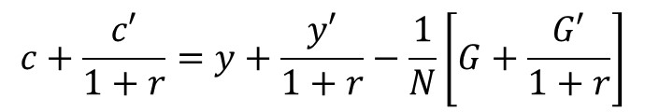
Ricardian Equivalence (3 of 3)
Then, substitute in the consumer’s budget constraint – taxes do not matter in equilibrium for the consumer’s lifetime wealth, just the present value of government spending.

Slide 42
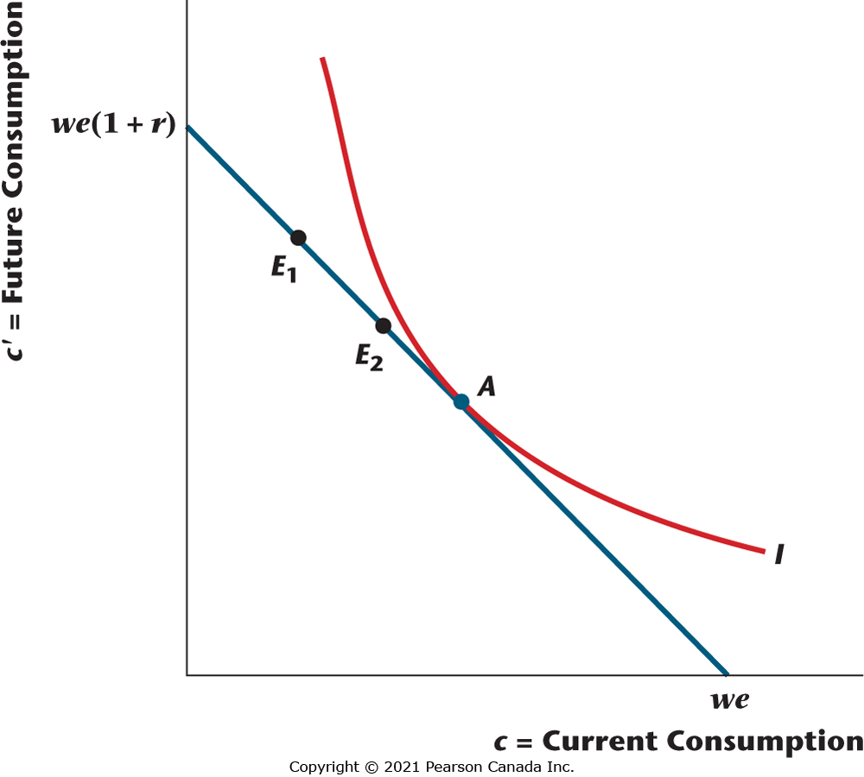
Figure 9.16 Ricardian Equivalence with a Cut in Current Taxes for a Lender
A current tax cut with a future increase in taxes leaves the consumer’s lifetime budget constraint unchanged, and so the consumer’s optimal consumption bundle remains at A. The endowment point shifts from E₁ to E₂, so that there is an increase in saving by the amount of the current tax cut.

Slide 43
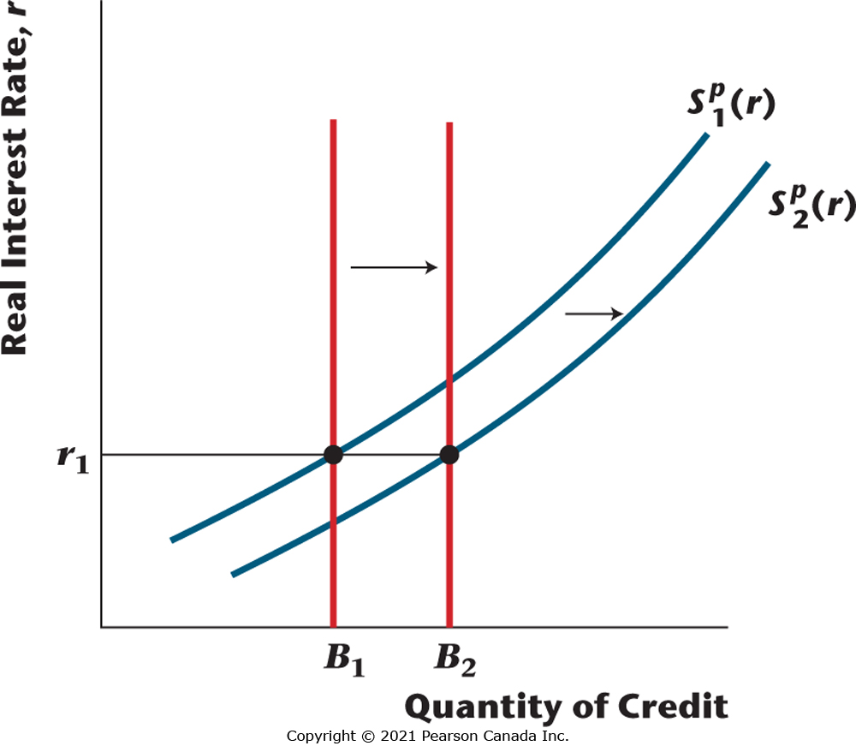
Figure 9.17 Ricardian Equivalence and Credit Market Equilibrium
With a decrease in current taxes, government debt increases from B₁ to B₂, and the credit supply curve shifts to the right by the same amount. The equilibrium real interest rate is unchanged, and private saving increases by an amount equal to the reduction in government saving.

Slide 44
Why Might Ricardian Equivalence Fail in Practice?
Redistributional effects of taxes: tax changes affect the wealth of different consumers differently.
Intergenerational redistribution: debt issued by the government today is paid off by future generations.
Taxes are not lump sum; they cause distortions.
Credit market frictions: Chapter 10.

